Slide 1
Starting Primary One
Guidance for Parents
Children and Young People’s Services
SEND Implementation Team

Slide 2
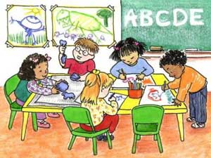
Starting School
When a child moves into Primary One they have to learn to cope with many changes. Do not worry if their skills seem to go backwards at first, this is quite normal as it is a big change for them. Acknowledge your child’s feelings and reassure them that they will soon get used to their new school. Stories and pictures about starting school can be helpful.
Environmental differences in:
Room, size and layout
Lighting and furniture
Equipment and resources
Toilets, cloakroom, play and eating areas
Social differences in:
School rules/expectations
Language and vocabulary
Relationships with others
Structure to the day
Increased number of verbal instructions

Slide 3
Children may feel:
Sad
Confused
Worried
Uncertain
Anxious
Overwhelmed
Hopeful
Insecure
Excited
Moving into Primary One can be a source of both excitement and anxiety for children and their parents. Throughout the transition process, young children need to feel secure and confident that their needs, wants, likes and dislikes will be understood.
Careful planning, preparation and collaboration between everyone involved should ensure that your child will transition smoothly and happily into their Primary One year in school.

Slide 4
The role of parents
Parental involvement in supporting your child in school is vitally important.
Creating positive partnerships with school staff at an early age will help your child to feel safe and achieve his or her full potential.
It is important to remember that we are all working together to get the best for the children.
Sharing key information about your child with the school is essential in order that their needs can be met effectively.
Clear communication and a consistent approach between home and school will help support children through transition.

Slide 5
The voice of the child
Young children depend on the adults around them to share important information about them that will allow their needs to be fully met.
Children have a unique view of their needs and capabilities and should be helped to express their opinions about matters that affect them in school.
The school will ensure that your child will be listened to and that their views will be valued.

Slide 6
Measures in school to help your child transition smoothly may include:
Visits / liaison by the Primary One teacher to the pre-school setting to meet children and discuss individual pupils.
Pre-school pupils coming to visit the school during “stay and play” sessions.
Sharing of information between
parents, pre-school staff and the
Primary One teacher.

Slide 7
Telling us about your child
Sharing information about your child is very helpful to the school in building up a picture of them so that their needs can be met and supported.
Information about your child may include:
Likes and dislikes
Favourite things
Fears
Sensory issues
Communication level
Independent self-management skills
Social Skills
Any other information that you feel the school needs to know in order to plan for your child coming into Primary One.
All information shared will be treated confidentially by the school

Slide 8
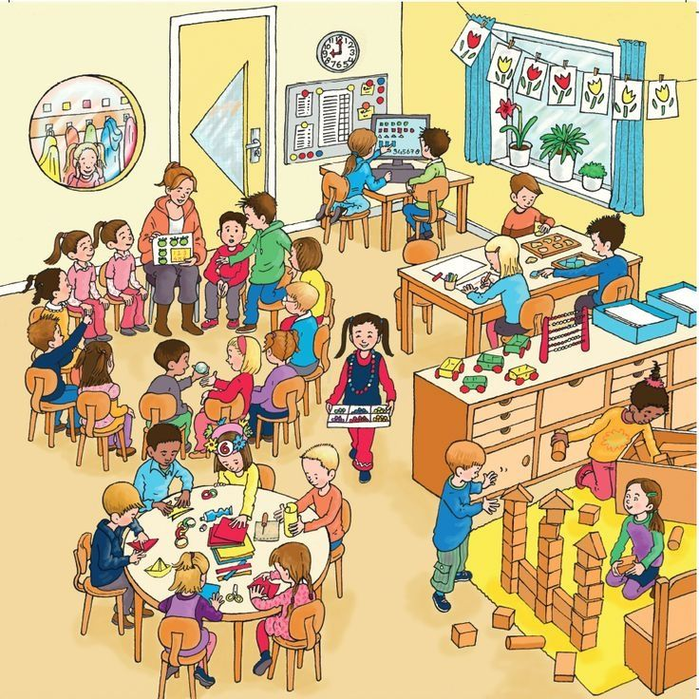
Meeting the needs of all learners in school
Children have different skills, abilities and interests, they make progress at different rates and have different ways in which they learn best. Praise your child for trying their best and don’t compare them with others, this will build their confidence.
If your child is provided with different work or activities in class from that of their classmates, you should not be worried. All children are different and teachers are highly skilled at using a wide range of approaches and strategies to help children learn.
Teachers look carefully at how they organise
lessons, the classroom, the materials and
activities they give to each child and the way
they teach. This is often called differentiating
the curriculum.

Slide 9
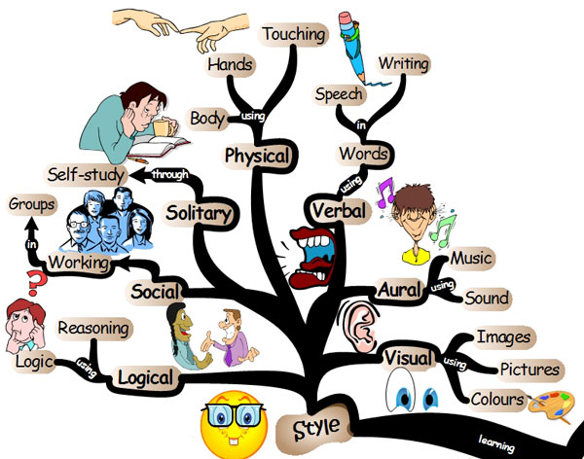
What our school does to support individual differences between learners
Lots of children will have learning difficulties from time to time and the school is well organised to address this by:-
Grouping the children for learning new tasks
Using different learning materials and resources
ICT
Over learning in the classroom
Small group withdrawal
Use of practical resources
Providing some small “catch up groups” for literacy and numeracy
Providing training for teachers
Most children with learning difficulties do not have Special
Educational Needs

Slide 10
What is meant by Special Educational Needs (SEN)?
In the 1996 Education Order a child is described as having special educational needs (SEN) if they have significantly greater difficulty in learning than the other children, that calls for special educational provision to be made. A child also has SEN if they have a disability that calls for special education provision that is additional to or otherwise different from what the other children of a similar age receive in an ordinary school.
If your child’s school thinks that your child needs special educational provision they will be placed on the school’s SEN Register and the school Special Needs Co-ordinator (SENCo) will oversee their special educational provision and monitor their progress on an individual education plan (IEP).
Only the school can decide if your child should be placed on the SEN register.
The school will meet with you to discuss your child’s needs and agree the targets for their Individual Education Plan (IEP) and what you can do to help address their learning needs.

Slide 11
What to do if you are concerned that your child may have Special Educational Needs
As your child moves through school their progress will be monitored and their teachers will build up a picture of their interests, skills and abilities.
The teachers in school are well trained to address learning needs and difficulties. The teacher will contact you if your child is not making the progress that they would expect.
Many children experience difficulties with their learning from time to time but only a small number have Special Educational Needs (SEN).
If you are worried about your child’s progress, contact the class
teacher who will arrange a time to meet with you. The teacher
will explain how your child is getting on in school and, if needed,
will address any concerns you may have. They will also advise you
on how you can help your child at home.

Slide 12
Getting ready to learn!
Give Your Child a Helping Hand
(DE & HSCT)
Help prepare your child for learning (suitable for children aged 0-4)
Top Tips booklet for Parents

